Slide 1


CDACL-006 Market Analysis
Market Analysis
Presentation
Insights & Strategic Marketing Recommendations

Slide 2


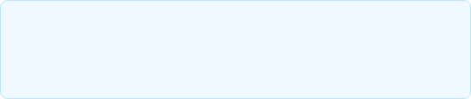
Project Objective
Analyze core customer purchasing behavior and product performance across multiple departments to extract actionable intelligence.
The primary goal is to leverage data validation to optimize marketing strategies and improve overall customer satisfaction.
Strategic Alignment
Translating raw order statistics into personalized marketing frameworks and robust operational recommendations.

Slide 3








Dataset & Analysis Approach
Data Extraction
Dashboarding
Insight Generation
SQL-based processing of comprehensive transaction logs, validating core inputs directly against final query outputs.
Creating dynamic Power BI visualizations to interactively monitor volume, reorder rates, and temporal purchasing patterns.
Bridging the gap between raw metrics and business meaning. Transforming descriptive statistics into prescriptive strategies.

Slide 4
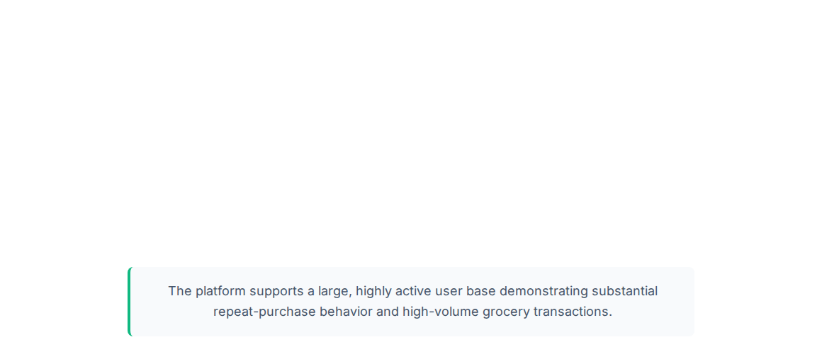



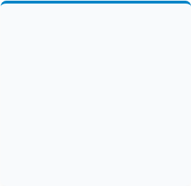
Executive KPI Snapshot
1.05M
63.1K
10.53
59.8%
TOTAL ORDERS
UNIQUE USERS
AVG PRODUCTS/ORDER
OVERALL REORDER RATE

Slide 5




Customer Purchasing Behavior
Basket-Based Shopping
Strong Repeat Purchasing
Insight
Insight
The average order contains 10.53 distinct products.
The platform maintains a 59.85% overall reorder rate.
Business Meaning: Customers are not typically performing one-product transactions; they use the platform for comprehensive grocery runs.
Business Meaning: The active user base is heavily engaged in recurring, replenishment-oriented shopping behavior.
Recommendation: Shift primary marketing focus toward basket growth, bundling, and intelligent cross-selling rather than isolated individual-product conversion.
Recommendation: Invest deeply in loyalty programs and an automated replenishment marketing engine to capitalize on predictable recurring demand.

Slide 6

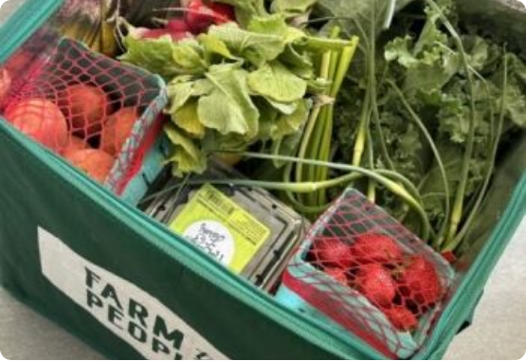
Product Performance Insights
Everyday Essentials Dominate
Order volume is heavily concentrated around fresh produce and core grocery items (e.g., Bananas, Organic Strawberries, Spinach, Avocados).
Popularity vs. Loyalty
A high-volume product does not necessarily guarantee the highest reorder rate. These distinct signals require separated marketing treatments.
Demand-Driven Assortment
Product assortment (total unique items in a category) alone should not dictate marketing visibility. It must be evaluated alongside actual order volume and loyalty metrics.

Slide 7
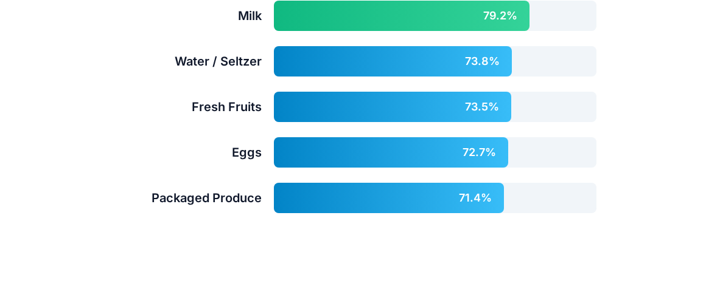
Category Reorder Behavior

Slide 8
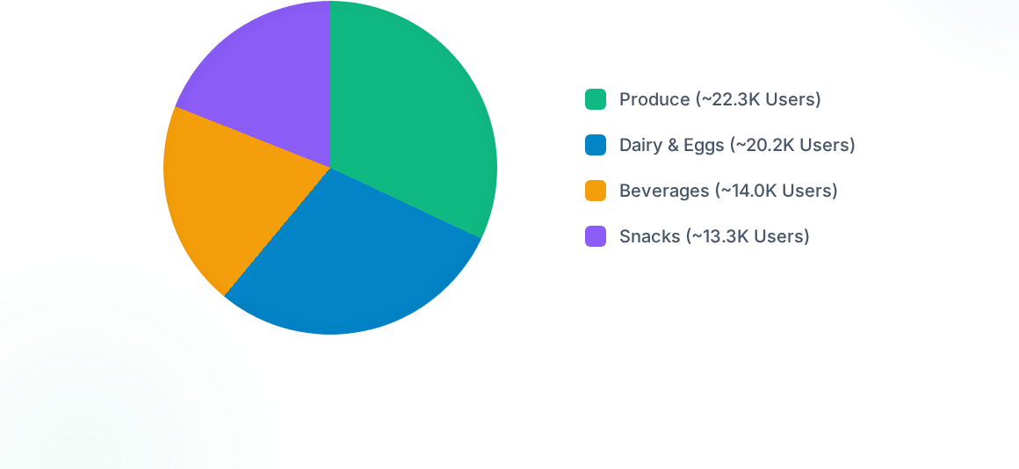
Department Customer Reach

Slide 9
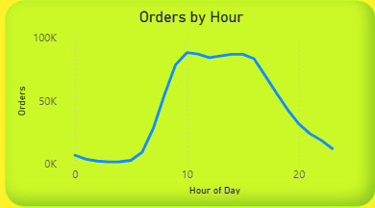

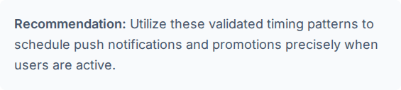
Time-Based Purchasing Patterns

Slide 10






Customer Frequency Segmentation
VIP & High-Frequency
Regular & Frequent
Occasional
Top-tier users with the highest order counts. Requires dedicated retention efforts, premium loyalty benefits, and exclusive access.
The core shopping base. Ideal target for basket size expansion, frequently-bought-together suggestions, and smart bundles.
Low frequency users. Marketing should focus on re-engagement campaigns, product discovery, and win-back promotions.

Slide 11
Marketing & Customer Satisfaction
Build a Replenishment Engine : Use high-reorder categories (Milk, Eggs, Fresh Fruits) to trigger personalized repeat-purchase prompts and recurring-order options.
Increase Basket Size via Cross-Selling : Leverage the 10.53 avg basket size to introduce 'complete your order' suggestions and complementary smart bundles.
Make Routine Shopping Easier : Implement a 'Your usual basket' or 'Buy Again' UX element allowing customers to instantly re-add their frequently purchased items.
Protect High-Reorder Inventory : Guarantee stock availability, robust inventory attention, and premium visibility for categories customers repeatedly depend on.

Slide 12
Recommended Segmentation Framework
Performance Segment | Business Meaning | Recommended Strategy
High Vol + High Reorder | Core products with both popularity and loyalty | Protect availability, loyalty campaigns, replenishment reminders
High Vol + Low Reorder | Popular products with weaker repeat behavior | Focus on discovery, targeted promotions, and cross-selling
Low Vol + High Reorder | Niche products with extremely strong loyalty | Targeted replenishment and highly personalized recommendations
Low Vol + Low Reorder | Weak demand/loyalty products | Review overall visibility, assortment, pricing, and promotion

Slide 13

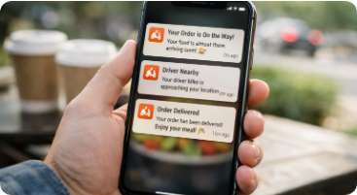

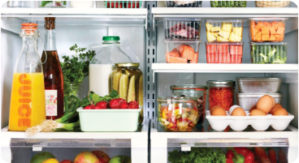


Key Business Takeaways
Automated Replenishment
Inventory Prioritization
Customer Experience
Prioritize personalized reminders for high-loyalty, everyday grocery items to secure recurring revenue.
Ensure maximum availability and visibility for the ~20K repeatedly reordered products.
Enhance satisfaction by simplifying routine shopping and timing campaigns to match validated behavioral peaks.

Slide 14

Conclusion & Next Steps
Analysis derived from validated SQL outputs and dashboarding. Ready for strategic implementation.

Slide 15





Image Sources
https://static.vecteezy.com/system/resources/thumbnails/078/645/776/small_2x/businessman-in-office-using-computer-monitor-for-data-analysis-and-finance-strategy-thoughtful-professional-man-looking-at-analytics-dashboard-charts-and-market-report-city-skyline-through-window-free-video.jpg
Source: www.vecteezy.com
https://cdn-ilemced.nitrocdn.com/SqMYyFrQNplpiMNaFWlDJqjyEDUfAVkC/assets/images/optimized/rev-7fefe1d/www.thegoodtrade.com/wp-content/uploads/2026/07/organic-produce-boxes-header-488x650-350x466.jpeg
Source: www.thegoodtrade.com
https://zeew.eu/wp-content/uploads/2026/01/ChatGPT-Image-Jan-27-2026-01_09_14-AM.png
Source: zeew.eu
https://naturefreshfarms.com/wp-content/uploads/2024/08/How-To-Organize-Your-Fridge-InsideFridge-terraskitchen.jpg
Source: naturefreshfarms.com
https://static.vecteezy.com/system/resources/thumbnails/072/330/335/small_2x/grocery-shopping-delivery-smiling-consumer-paying-with-debit-card-for-groceries-receiving-shopper-with-food-products-from-supermarket-african-american-courier-guy-giving-mesh-bag-to-client-at-home-photo.jpg
Source: www.vecteezy.com

